Slide 1



Machine Learning
Data Series 18.0
Student Scores Prediction
Dibuat oleh :
Dzulfiqar Ahnaf Nur Avicena
www.linkedin.com/in/dzulfiqar-ahnaf-nur-avicena

Slide 2
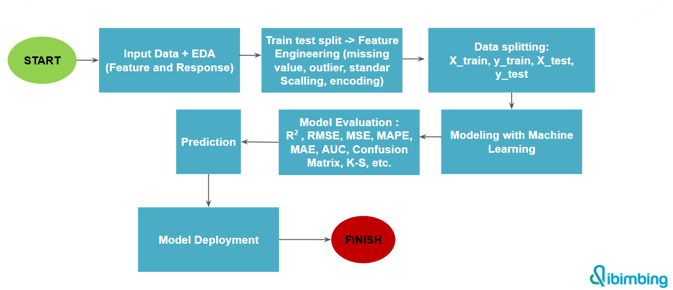

Flowchart

Slide 3


Tools

Slide 4
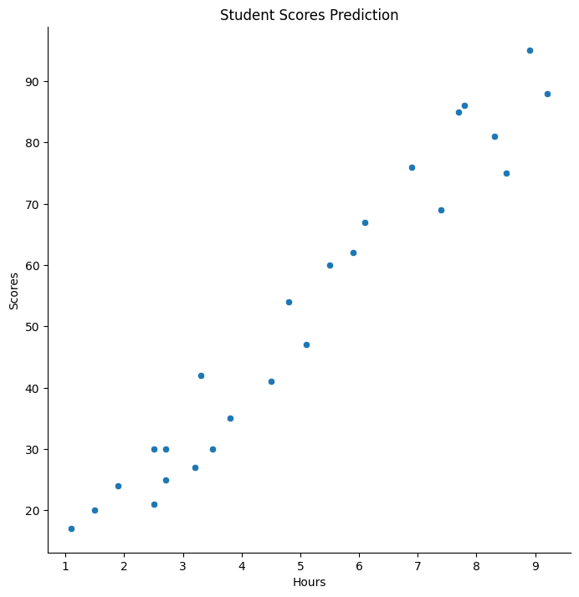
Student scores are based on hours
This scatter plot shows the relationship between the number of hours studied (Hours) and test scores (Scores). From the pattern of data points, it can be seen that the longer the study time, the higher the score obtained, which indicates a positive correlation between the two variables.
This plot is used for regression analysis to predict scores based on the number of hours studied.

Slide 5
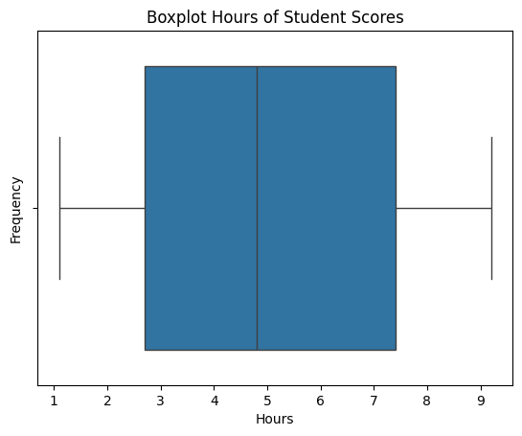
Boxplot Hours of Student Scores
The boxplot shows the interquartile range (IQR), namely the range between the first quartile (Q1) and the third quartile (Q3).
The line in the box (median line) shows the median value of the number of student study hours.
The horizontal line (whiskers) shows the data range without outliers, namely the minimum and maximum data within the IQR limits.
There are no visible outliers (points that are outside the whiskers).

Slide 6
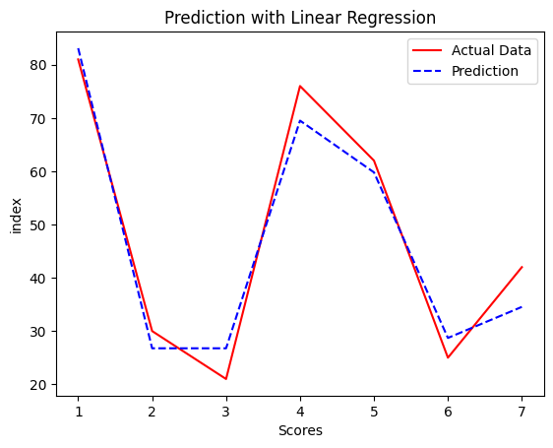
Prediction with Linear Regression
The red line (Actual Data) shows the original value of the student's score.
The dotted blue line (Prediction) shows the prediction results of the linear regression model.
The X-axis (Scores) represents the score values, while the Y-axis (Index) appears to represent the order of the data.
From this graph, it can be seen that the predictions are quite close to the original data, although there are some deviations. This shows that the linear regression model is able to capture data patterns well, but may still be improved with further optimization.

Slide 7
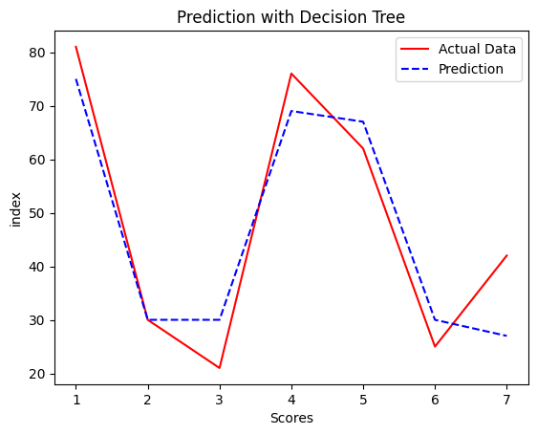
Prediction with Decision Tree
The red line (Actual Data) is the actual student score data.
The dotted blue line (Prediction) is the prediction result from the Decision Tree model.
The X-axis (Scores) is what represents the student's score.
The Y axis (Index) is what represents the data sequence or observation index.
It can be seen that the Decision Tree model is more flexible than linear regression, following data patterns better. However, Decision Trees can also cause overfitting, especially if the model is too complex and overfit to the training data.

Slide 8
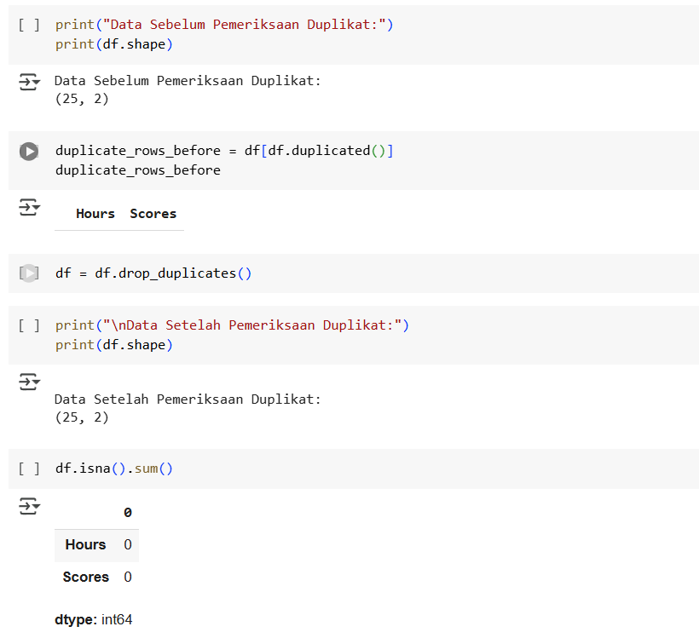
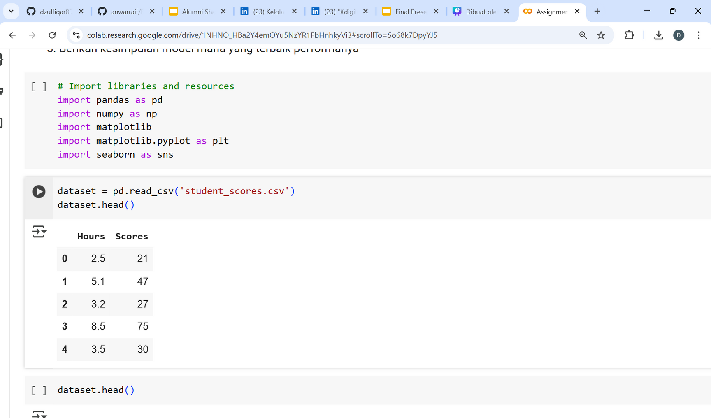
Preparing datasets
Prepare the "Student Scores Prediction" dataset to solve existing problems. (check duplicated data, check missing value handling, outlier analysis)

Slide 9
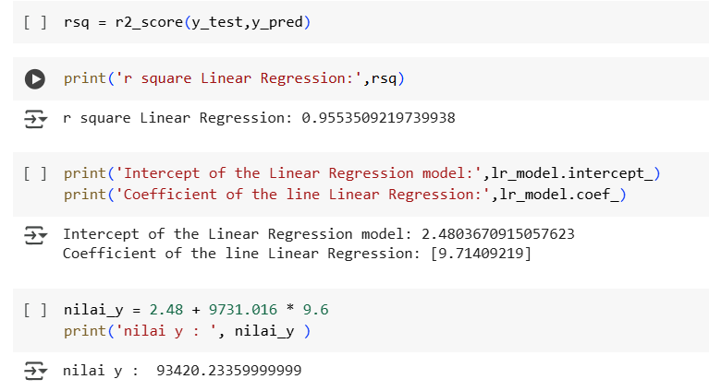
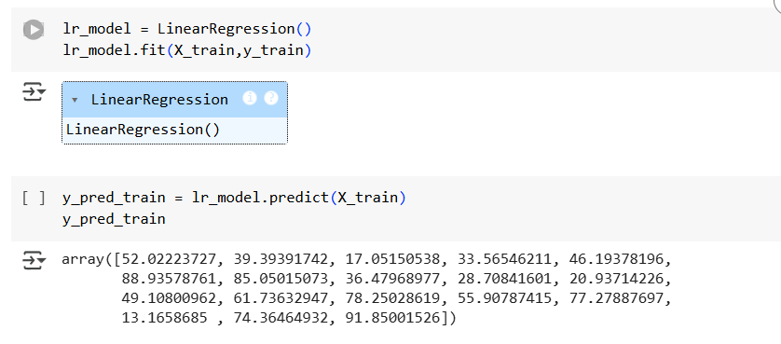
Modelling Machine Learning Regression (Linear Regression)

Slide 10
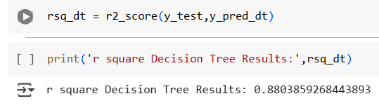
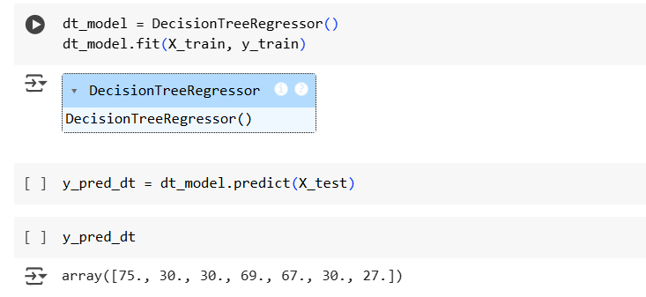
Modelling Machine Learning Regression (Decision Tree)

Slide 11
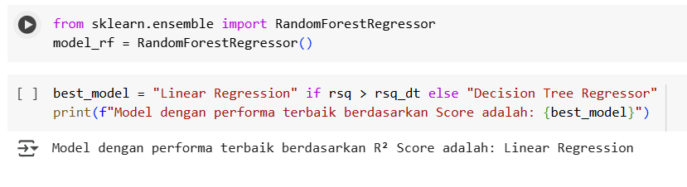
Conclusion

Slide 12
Source Code Github
check my repository for more details
https://github.com/dzulfiqar890/ML-AI-StudentScores-Prediction

